Slide 1
Topics of this course
What is CS ?
Lect 1: what is computer
Lect 2: how is computer system working
Lect 3: TM & P vs NP
Lect 4: computational thinking & algorithm
Why is CS so hot ?
How to learn CS ?

Slide 2
Lecture 4: computational thinking & Algorithm
qiang@suda.edu.cn

Slide 3
What is computational thinking?
a high-level cognitive process that allows us to think scientifically (not just but mainly computationally) when solving problems.
Wing, J.M. (2006). Computational thinking. Communications of the ACM, 49(3), 33-35.

Slide 4
How we solve real world problems
A real world problem
modeling
Math-oriented
Modeled problem
Comp-oriented
Solving
techs
????-oriented

Slide 5

An example: 1D random walk
1D random walk
Coin head/tail: up/down 1 step
When walking long N steps
how far average from the original ?
0?

Slide 6
1D random walk computational thinking
Simulate one trial
Do much trials
Record distance of each trial
Collect and calculate the average distance

Slide 7
Computational steps
Analysis. When solving a problem, you always have to analyze the problem thoroughly beforehand.
Abstraction. The second step is to know how to formulate the problem. What’s actually happening? Is there a pattern? What strategy can I design? What comes to mind from past experiences related to this same situation?
Expression of the solution or proposal. After mentally designing the strategy you need to follow, it’s time to apply it and test it.
Evaluation. After the execution, it’s time to evaluate. Did I get the desired result or can I improve it in any way?
Generalize and transfer. When evaluating the success of what you’ve obtained, you can use what you’ve developed to apply it to other areas.

Slide 8
1、Define modeled QUESTIONS
Think through the scope and details of the problem, defining manageable questions to tackle. Identify the information you have or will need to obtain in order to solve the problem.
For 1D random walk problem, naïve and brute force solution

Slide 9
2、ABSTRACT TO COMPUTABLE FORM
Transform the question into an abstract precise form, such as code, diagrams or algorithms ready for computation. Choose the concepts and tools to use to derive a solution.
For 1D random walk problem: algorithm design
Simulate one trial
Repeat and record enough trials

Slide 10
3、COMPUTE ANSWERS
Turn the abstract question into an abstract answer using the power of computation, usually with computers. Identify and resolve operational issues during the computation.
For 1D random walk problem:
programming correctly and elegantly
Run code

Slide 11
4、INTERPRET RESULTS
Take the abstract answer and interpret the results, recontextualizing them in the scope of your original questions and skeptically verifying them. Take another turn to fix or refine, if need.
For 1D random walk problem, find other independent evidence to verify your answer.

Slide 12
The characteristics of computational thinking
Decomposing
Knowing how to recognize patterns
Abstract thinking
Algorithms

Slide 13
Computational thinking and computing technology.
Computational thinking is seeds (世界观方法论)
Computing foundations are soil （环境）
Computing technologies are water & fertilizer （解决问题的工具）
Fruits

Slide 14
Computational thinking is and is not
Conceptualizing, not programming
Fundamental, not rote skill
A way that humans, not computers, thinking
Complements and combines mathematical and engineering thinking
Ideas, not artifacts

Slide 15
Rephrase computational thinking
Logical thinking
Algorithmic thinking
Efficiency thinking
Scientific thinking
Innovative thinking

Slide 16
What is algorithm?
“A finite set of rules that gives a sequence of operations for solving a specific type of problem.” -- Knuth 3rded, 1998
Not too long
Step by step
Not for too general problems
Not for a single problem
Performed on computer (default)

Slide 17
What is algorithm: important features
Input
Output
Finiteness
Definiteness
Effectiveness

Slide 18
CS and algorithm
One important part of CS is about art of algorithms
The art of computer programming -- Knuth’s famous book title
Design elegant algorithms
Make them run efficiently and fast on computer

Slide 19
How to evaluate an algorithm?
Correctness
Efficiency
Space
Time

Slide 20
Reasons to analyze algorithms
Predict performance
Compare algorithms
Provide guarantees
Understand theoretical basis
Primary practical reason: avoid performance bugs

Slide 21
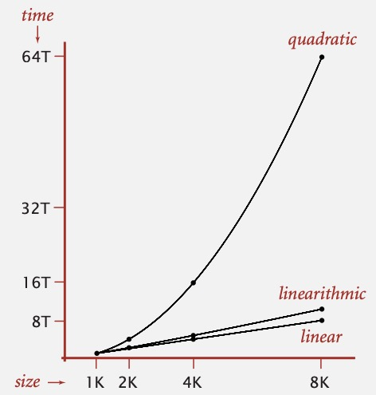
Some algorithmic successes
Discrete Fourier transform.
Break down waveform of N samples into periodic components.
Applications: DVD, JPEG, MRI, astrophysics, ….
Brute force: $N^{2}$ steps.
FFT algorithm: $NlogN$ steps, enables new technology.
Friedrich Gauss
1805

Slide 22
The challenge
Q. Will my program be able to solve a large practical input?
Why is my program so slow ?
Why does it run out of memory ?

Slide 23
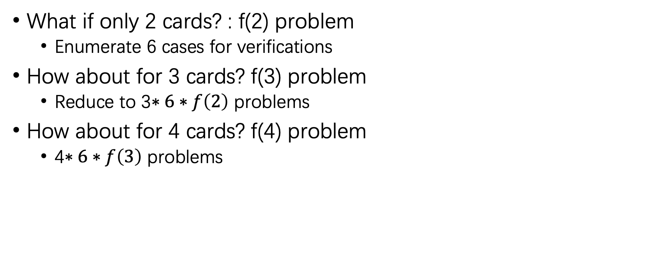
Algorithm of S24 game
What if only 2 cards? : f(2) problem
Enumerate 6 cases for verifications
How about for 3 cards? f(3) problem
Reduce to 3$∗6∗f\left(2\right)$ problems
How about for 4 cards? f(4) problem
4$∗6∗f\left(3\right)$ problems

Slide 24
Mathematical models for running time
Total running time: sum of cost$×$frequency for all operations.
Need to analyze program to determine set of operations.
Cost depends on machine, compiler.
Frequency depends on algorithm, input data.
Donald Knuth
1974 Turing Award

Slide 25
Types of analyses
Ex 1. matrix multilication.
Best: ~ N³
Average: ~ N³
Worst: ~ N³
Best case. Lower bound on cost.
Determined by “easiest” input.
Provides a goal for all inputs.
Worst case. Upper bound on cost.
Determined by “most difficult” input.
Provides a guarantee for all inputs.
Average case. Expected cost for random input.
Need a model for “random” input.
Provides a way to predict performance.
Ex 2. Compares for binary search.
Best: ~ 1
Average: ~ lg N
Worst: ~ lg N
Upper bound. Performance guarantee of algorithm for any input.
Lower bound. Proof that no algorithm can do better.
Optimal algorithm. Lower bound = upper bound (to within a constant factor).

Slide 26
Commonly-used notations in the theory of algorithms
notation | provides | example | shorthand for | used to
Big Theta | asymptotic order of growth | $$Θ(N^{2})$$ | $$1/2N^{2}$$ $${10N}^{2}$$ $${5N}^{2}+22N\log{N}+3N$$ $$⋮$$ | classify algorithms
Big Oh | $Θ(N^{2})$ and smaller | $$Ο(N^{2})$$ | $${10N}^{2}$$ $$100N$$ $$22N\log{N}+3N$$ $$⋮$$ | develop Upper bounds
Big Omega | $Θ(N^{2})$ and larger | $$Ω(N^{2})$$ | $$1/2N^{2}$$ $$N^{5}$$ $$N^{3}+22N\log{N}+3N$$ $$⋮$$ | develop Lower bounds

Slide 27
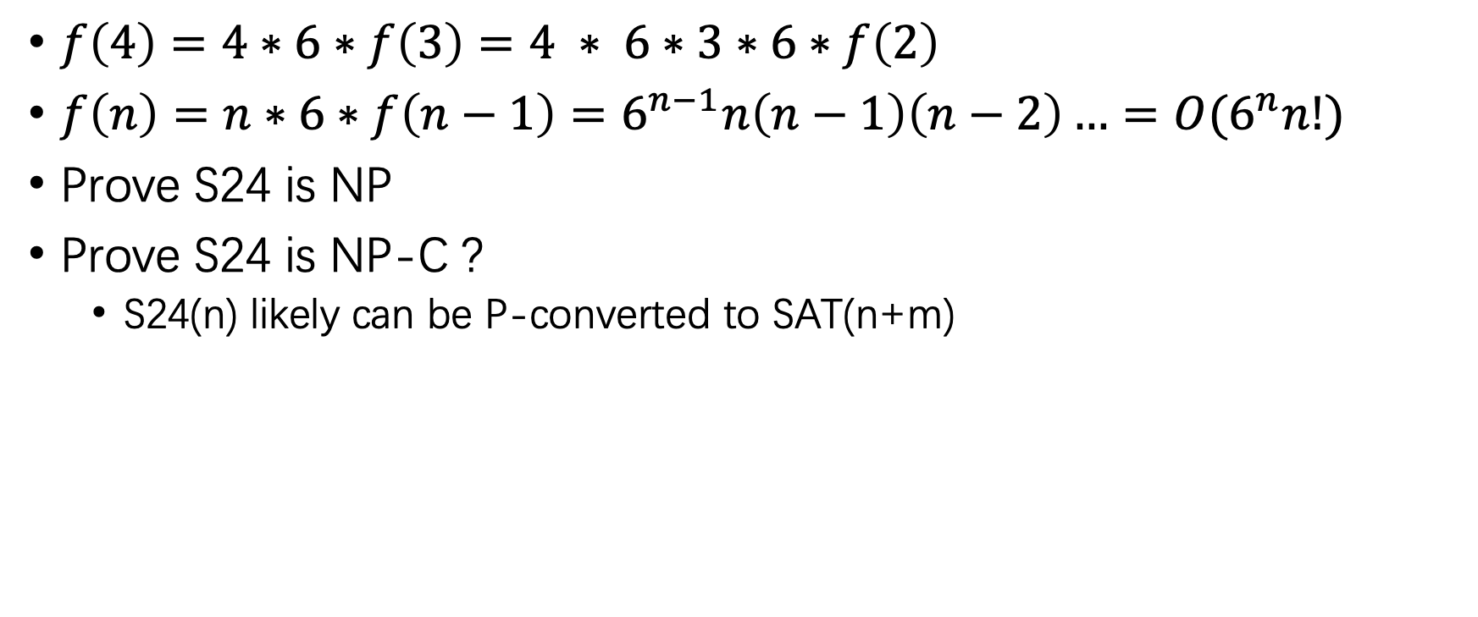
S24 game time analysis
$f\left(4\right)=4∗6∗f\left(3\right)=4 ∗ 6∗3∗6∗f\left(2\right)$
$f\left(n\right)=n∗6∗f\left(n−1\right)=6^{n−1}n\left(n−1\right)\left(n−2\right)…=O(6^{n}n!)$
Prove S24 is NP
Prove S24 is NP-C ?
S24(n) likely can be P-converted to SAT(n+m)

Slide 28
Memory
Bit. 0 or 1.
Byte. 8 bits.
Megabyte (MB). 1 million or 2²⁰ bytes.
Gigabyte (GB). 1 billion or 2³⁰ bytes.
NIST
most computer scientists
For 1D random walk problem
Record by trials: need tries memory
Record by distance: need n memory
Sort 1K records is totally different problem from sort 1T records in algorithmic view!

Slide 29
Home work 4
Analyze the time complexity of your S24 solution presented in Homework3.
Improve your above solution. What is the time complexity for the improved version?
Can you identify the fastest solution for S24 (4 cards) game?

